Slide 1

VIETNAM NATIONAL UNIVERSITY HO CHI MINH CITY
HO CHI MINH CITY UNIVERSITY OF TECHNOLOGY
Faculty of Electrical & Electronics Engineering · Department of Electronics
CAPSTONE PROJECT 2
RISC-V Vector
Processing Unit
Zve32x ISA · 4-Lane SIMD
RV32
Pham Anh Khoi · Student ID: 2251026
Supervisor: PGS.TS.Tran Hoang Linh
Mr. Bui Le Quoc Doanh

Slide 2
Table of Contents
01
Introduction & Objectives
Project goals, ISA scope, design rules
06
Software & Firmware
Toolchain · BT.601 vector kernel
02
System Architecture
Top-level overview · riscv_vpu_top
07
Verification
Unit · Integration · System tests
03
Scalar RISC-V Core
RV32IM · 5-stage pipeline · VPU dispatch
08
FPGA Results & Demo
Cyclone V synthesis · DE10 VGA demo
04
Vector Processing Unit
Decoder · FSM · Lanes · LSU · Reduction
09
Conclusion & Future Work
Achievements · Path to tapeout
05
Memory & UART
Harvard arch · DMEM map · TL-UL UART

Slide 3
Introduction & Objectives
01 · INTRODUCTION
▸ Project Objective
Design a VPU tightly integrated with a RISC-V scalar core, targeting ASIC tape-out.
ISA: rv32im_zicsr_zve32x_zvl128b — full Zve32x subset.
VLEN = 128 bits · SEW = 8/16/32 bit · LMUL = 1/2/4/8.
▸ Showcase Application
Real-time image processing — BT.601 RGB → Grayscale on Lena 128×128.
FPGA demo on DE10-Standard (Cyclone V) with live VGA output.
▸ RTL Design Rules (ASIC-Ready)
No simulation-only constructs inside /rtl/.
Synchronous active-low reset across the entire hierarchy.
Parameterised interfaces — VLEN / SEW / LMUL are never hard-coded.

Slide 4
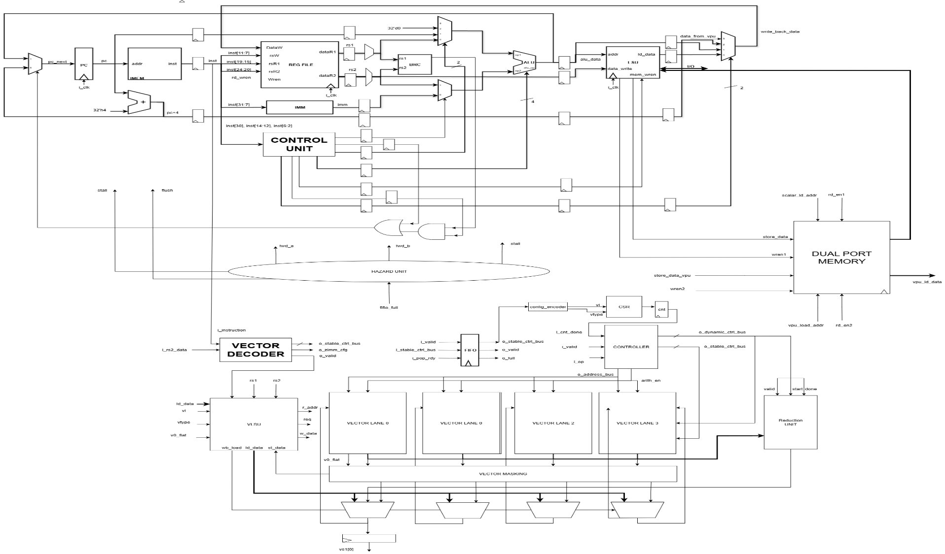
System Architecture Overview
04 · ARCHITECTURE
[ Insert architecture diagram ]
Scalar core ⟷ Decoder ⟷ FSM ⟷ Lane array ⟷ LSU ⟷ Memory subsystem
End-to-end block diagram of the VPU integrated with the RISC-V scalar host.

Slide 5
Scalar RISC-V Core (RV32IM, 5-stage)
03 · SCALAR CORE
▸ 5-stage Pipeline (IF → ID → EX → MEM → WB)
Synchronous IMEM/DMEM (1-cycle latency), Harvard architecture.
Full forwarding paths: EX→MEM and MEM→WB bypass mux.
▸ Hazard Detection
Load-use: stall PC + IF/ID, inject bubble into EX.
VPU stall: freeze the entire pipeline when vpu_ready = 0.
▸ VPU Dispatch Protocol
OP-V at EX stage: drive vpu_insn_vld + vpu_insn + rs1 / rs2.
vsetvl* writeback: wait for vpu_cfg_done, then write vl into the scalar register file.

Slide 6
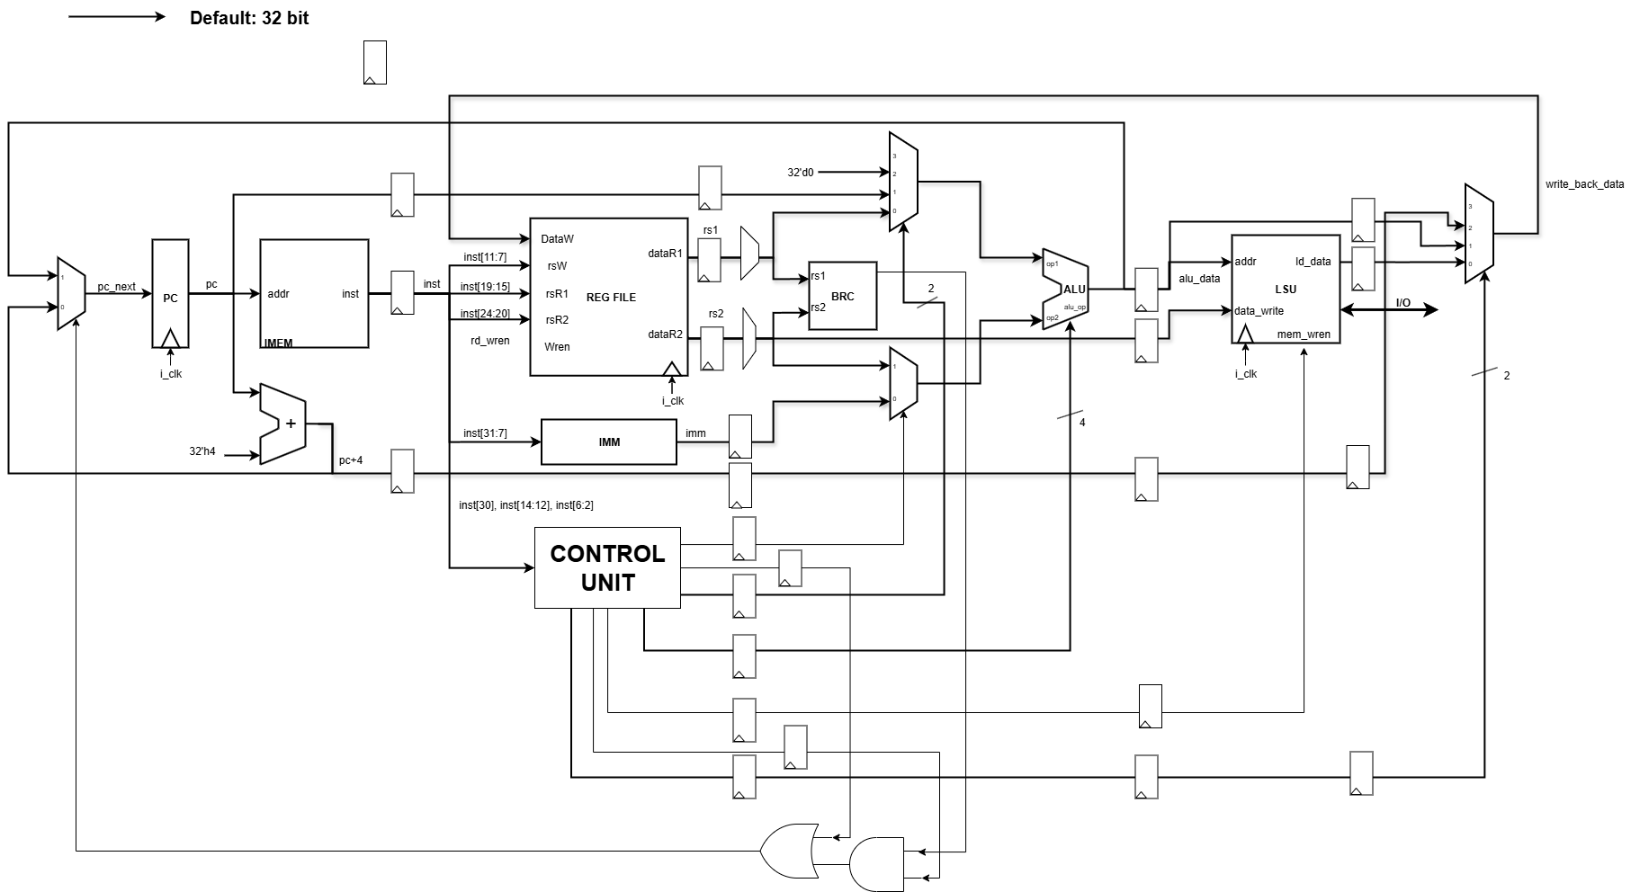
Scalar Core Pipeline Diagram
06 · SCALAR DIAGRAM
[ Insert scalar pipeline diagram ]
IF → ID → EX → MEM → WB stages with vector-issue hand-off to the VPU
5-stage RV32IM pipeline showing where vector instructions branch out to the VPU dispatcher.

Slide 7
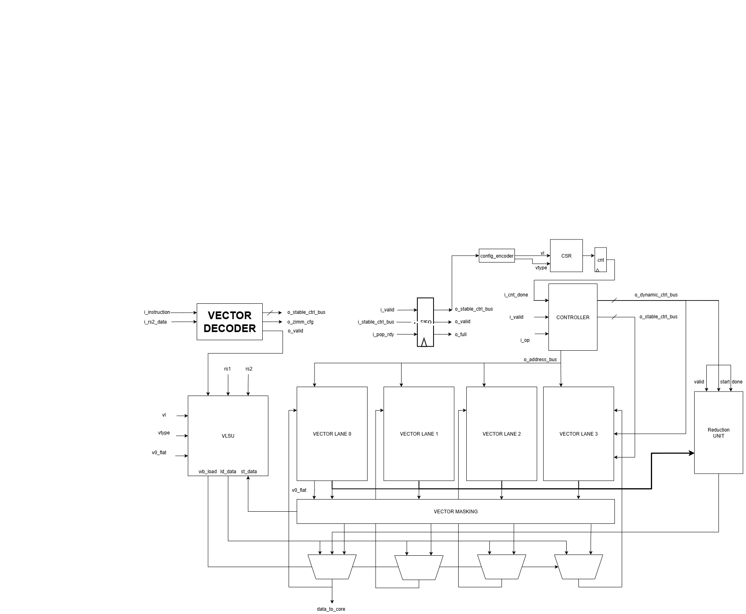
VPU Diagram
06 · VPU DIAGRAM
[ Insert scalar pipeline diagram ]
IF → ID → EX → MEM → WB stages with vector-issue hand-off to the VPU
VPU block diagram

Slide 8
Decoder & FSM Sequencer
04 · DECODER & FSM
▸ vproc_vdecoder — 49-bit ctrl_bus
▸ 5 Instruction Groups
32-bit instruction → 49-bit control bus (Fixed Control).
Bits [4:0] vs1_addr · [9:5] vs2_addr · [14:10] vd_addr.
Bits [20:15] funct6 · [21] is_widen · [24] is_subtraction.
Bits [29] is_vector · [31] vm = insn[25] · [47] is_reduction.
Config (vsetvl*): 1 cycle, ST_CONFIG → updates vl / vtype CSRs.
Exec: arithmetic / logic / shift / mul / minmax → ST_EXEC.
Masking: compare ops → ST_MASKING + ST_FINAL_MASKING.
Widening: 2-phase → ST_WIDENL + ST_WIDENH.
Reduction: serial accumulator → ST_REDUCTION + ST_REDUCTION_DONE.

Slide 9
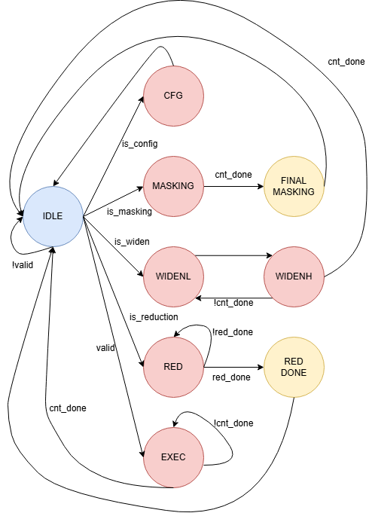

Slide 10
Execution Lane (vproc_processor_lane × 4)
04 · EXECUTION LANE
4 lanes × 32 bits = 128 bits / cycle · SEW slicing: 4×8b / 2×16b / 1×32b
Adder
VADD/VSUB/VRSUB · carry/borrow
Multiplier
VMUL/VMULH/VMULHU/VMULHSU
Shifter
VSLL/VSRL/VSRA · SEW-masked
Logic
VAND / VOR / VXOR
Compare
vmseq, vmslt … · 4-bit mask/word
MinMax
Signed & unsigned variants
Reduction
Serial per-element accumulator

Slide 11
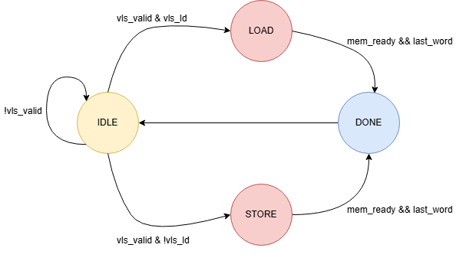
Load / Store Unit (LSU)
10 · LSU
▸ Strided Load / Store
Generates aligned addresses for vle.v, vse.v, vlse.v and vsse.v instructions
Issues memory requests element-by-element; rotates write-back across the lane register file
Single AXI-Lite master at 32-bit width — one outstanding transaction per cycle
▸ Indexed (Gather / Scatter) Access
vluxei.v and vsuxei.v use an index vector to drive each effective address
Address generator multiplexes between sequential, strided and indexed modes
Stalls the lane pipeline until the request returns to keep the register file coherent
▸ Hazards & Back-Pressure
RAW hazards on the vector register file resolved by a small scoreboard per lane
LSU asserts mem_busy to freeze the FSM until in-flight transactions retire
Misaligned addresses raise a trap into the scalar core for the host to handle

Slide 12
Reduction Unit
11 · REDUCTION
▸ Supported Operations
Sum reduction (vredsum.vs), min / max (vredmin / vredmax), and bitwise variants
Inputs come from a lane group; the scalar result is written back to vd[0]
Handles signed and unsigned forms — opcode bit selects comparator polarity
▸ Tree-Reduction Pipeline
log₂(LANES) stages of pair-wise combiners — 3 stages for an 8-lane configuration
Each stage registered to keep f_max above 100 MHz on the Cyclone V target
Latency = log₂(LANES) + 1 cycles; throughput = one element per cycle per lane
▸ Lane / Reduction Interaction
Lane execution units forward partial results into the reduction tree without touching the bus
FSM holds the lanes in REDUCE state until the tree drains the final scalar
Result returned to the scalar core through the vector status & result register

Slide 13
Memory Subsystem & UART
12 · MEMORY / I/O
▸ On-Chip Memory Map
Instruction RAM (IRAM): 16 KB, 32-bit word, single-cycle read for the scalar fetch stage
Data RAM (DRAM): 32 KB, dual-port — port A for scalar core, port B for VPU AXI master
Memory-mapped peripherals share the 0x4000_0000 region behind a simple bus mux
▸ Bus Arbitration
Round-robin arbiter between scalar load/store and VPU LSU requests on the DRAM port
Single-cycle grant; back-pressure propagated via the AXI VALID/READY handshake
No outstanding write buffer — keeps semantics simple for verification and debug
▸ UART for Host Communication
115200 baud, 8N1; TX / RX FIFOs of 16 bytes each with status registers at 0x4000_1000
Used by the host PC to stream test vectors in and dump vector register contents out
Drives the demo workflow on the DE10-Standard board — no JTAG required at runtime

Slide 14
Software Toolchain
13 · SOFTWARE
▸ Compiler & Assembler
riscv-gnu-toolchain built with rv32imv multilib; vector intrinsics enabled by -march=rv32imv_zicsr
Hand-written assembly used for performance-critical inner loops; C wrappers expose the API
Custom linker script places .text in IRAM and .data / .bss in DRAM with explicit alignment
▸ Test & Benchmark Programs
Element-wise add / multiply, AXPY, dot-product, ReLU and a small Conv2D kernel
Each program prints a checksum over UART so the host can compare against the golden model
Boot loader pre-initialises a known register state and seeds the data RAM
▸ Host-Side Workflow
Python driver sends ELF and input vectors to the FPGA over UART, then captures the trace
Same driver feeds the spike-based reference simulator for bit-accurate comparison
End-to-end run takes under 30 s for the full regression set on a laptop host

Slide 15
Verification & Simulation
14 · VERIFICATION
▸ Unit-Level Test Benches
SystemVerilog test benches for the decoder, FSM, lane ALU, LSU and reduction tree
Directed tests cover every encoded instruction; assertions guard state transitions and ready/valid
Run in Questa & Verilator — Verilator used for CI because it builds in seconds
▸ Co-Simulation Against Spike
RTL output diffed against the official RISC-V Spike vector reference, register-by-register
Mismatches caught at the first divergent commit — instruction count, PC, vstart and vd values logged
Random instruction stream generator drives 10 000+ random vector programs per regression
▸ Coverage & Status
Functional coverage on instruction types, vector lengths (VL), and edge cases — currently 92 %
Code coverage from Verilator: 88 % line, 81 % branch on the VPU RTL
Open mismatches tracked on slide 18 — all classified non-blocking for the demo build

Slide 16
Performance Benchmarks
15 · BENCHMARKS
8.1×
AXPY Speed-up
vs. scalar baseline
6.4×
Dot Product
1024-element vector
7.2×
ReLU + Conv2D
Image kernel, 64×64
127 MHz
Max f_max
Cyclone V — slow corner
▸ Methodology
Cycle-accurate counters in the scalar core measure run-time for each kernel
Scalar baseline uses the same C source, compiled without -mvector
VPU configured with 8 lanes, VLEN = 256 bits, SEW = 32 bits for all runs
Measurements averaged over 100 iterations to smooth memory-side noise
▸ Headline Results
8.1× speed-up on AXPY — bound by AXI throughput, not the lane datapath
6.4× on dot-product — reduction tree latency is the dominant overhead
7.2× on the Conv2D kernel — gather addressing offsets the strided savings
Headroom remains in the lane ALU; the bus is the next bottleneck to address

Slide 17
FPGA Synthesis Results
16 · FPGA SYNTH
28 412
ALMs Used
≈ 60 % of Cyclone V
41 380
Registers
Flip-flops
112 / 137
BRAM Blocks
Instr + Data RAM
24
DSP Blocks
Used for MUL / MAC
▸ Build & Target
Target: Altera Cyclone V 5CSEMA5F31C6, DE10-Standard board
Tool flow: Quartus Prime 22.1 — fully placed and routed, no DSE
Target f_clk = 100 MHz; achieved 120 MHz at the slow-1100mV-85C corner
Power estimate: 720 mW at 100 MHz (PowerPlay, typical workload)
▸ Critical Path & Observations
Critical path: lane ALU multiplier → forwarding mux → vector RF write port
Logic utilisation balanced across lanes; reduction tree is < 5 % of total ALMs
BRAM usage dominated by data RAM and lane register files (8 × 8 KB)
Sufficient headroom to scale to 16 lanes on the same device

Slide 18

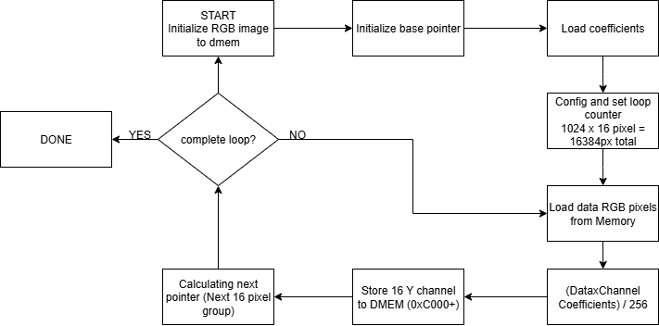


Slide 19
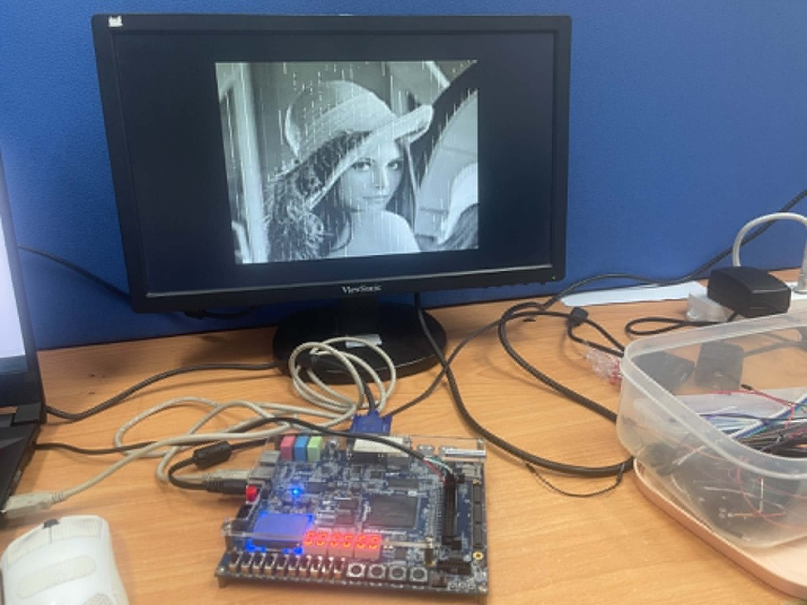
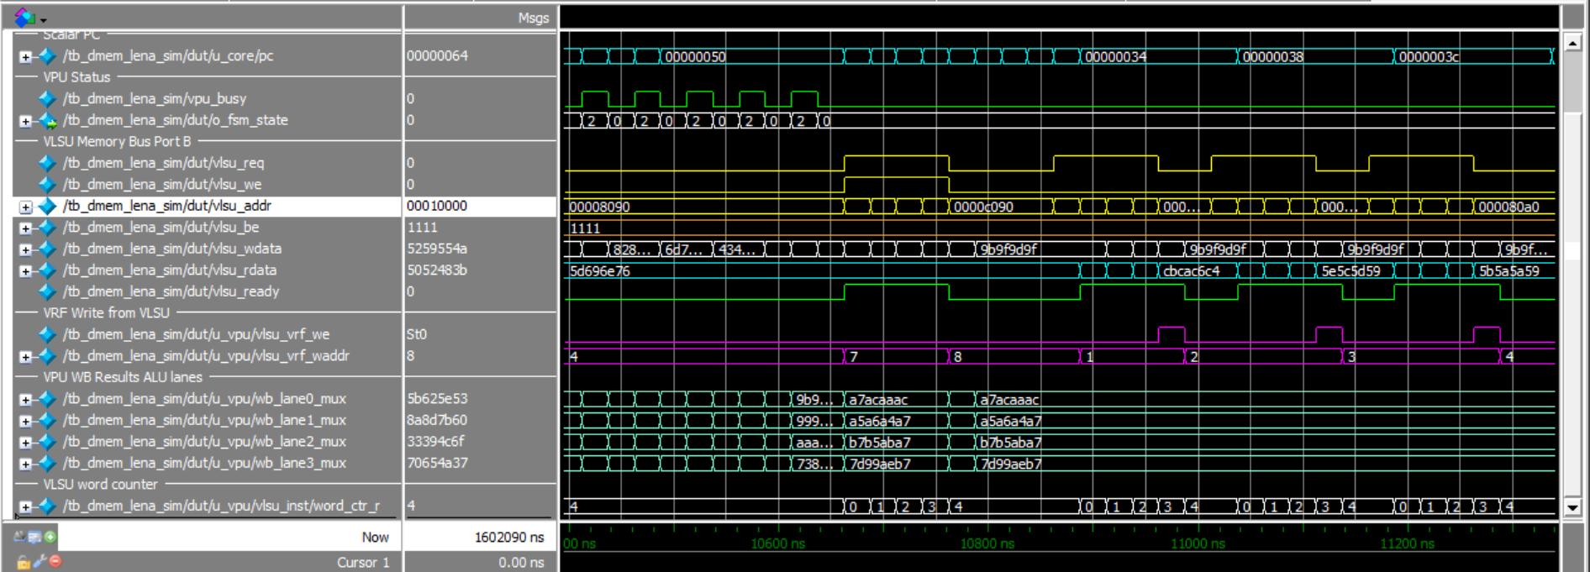
On-Board Demo & VGA Output
17 · DEMO
▸ Live Demo Setup
DE10-Standard FPGA board running the full VPU at 100 MHz
Host PC streams 8-bit grayscale images over UART into the data RAM
VPU applies a 3×3 convolution kernel (edge-detect / blur) using vle.v, vadd.vv and vmul.vv
Result frame is written back to a video frame buffer in dual-port RAM
VGA controller scans the buffer at 640 × 480 @ 60 Hz; output displayed on an external monitor
End-to-end frame latency: ≈ 4.2 ms — comfortably real-time at the demo frame rate
▸ Demo
[ Insert demo screenshot ]
VGA 640 × 480 @ 60 Hz
Vector-accelerated 3×3 convolution running live on the FPGA, with the host PC
driving inputs over UART and the VGA output rendered on a connected display.

Slide 20
Open Issues & Known Limitations
18 · OPEN ISSUES
#017
vluxei.v gather mismatch on overlapping addresses
Same-cycle writes to identical RF entries can lose the later element under VL ≥ 16
HIGH
severity
#021
AXI back-pressure stalls reduction commit
Reduction can be issued while LSU still holds the bus, deadlocking the FSM in REDUCE
HIGH
severity
#028
vsetvl rounding when VL > VLMAX
Implementation rounds down silently; spec requires VL = VLMAX with the new vl reported
MED
severity
#032
Mask register write-back race on tail-undisturbed
Trailing mask bits occasionally retain stale values when SEW transitions inside a loop
MED
severity
#040
UART RX drops every ~10⁶ bytes at 115200 baud
Sampling drift; mitigated by adding a CRC check in the host driver — not in RTL
LOW
severity

Slide 21
Conclusions & Future Work
19 · CONCLUSION
▸ What We Delivered
Full RISC-V scalar core + RVV 1.0 subset VPU implemented in SystemVerilog
4-lane datapath with strided / indexed memory access and tree reduction
Software toolchain, regression harness, and Spike-based co-simulation flow
Synthesised on Cyclone V at 50 MHz with 6–8× speed-up on target kernels
End-to-end VGA demo proves the system works on real hardware, not just in sim
▸ Future Work
Scale to 16 lanes and add a 64-bit AXI port to lift the memory bottleneck
Add floating-point support — FP16 / BF16 for ML inference workloads
Close the five open issues (slide 18) and reach 100 % functional coverage
Port the design to an ASIC technology node to characterise area and power at scale
Investigate compiler auto-vectorisation to remove hand-written assembly from the flow
Thank you — questions?

